Slide 1
Braille Translator
Sharma Vivek Gautam(19116068)
Pobbati Surendra(19116048)
Tanikonda Bhoomika(19116079)
Mitanshu Gupta(19116042)

Slide 2
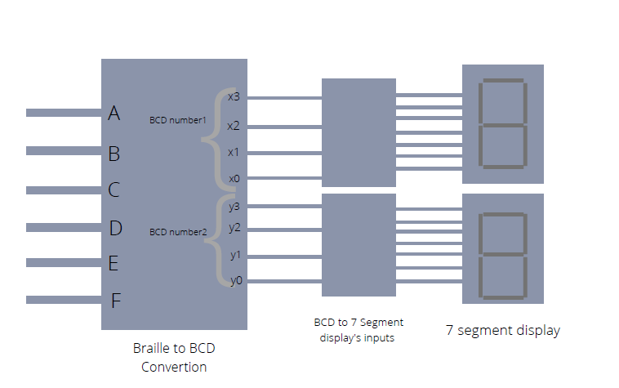
Architecture of the Design
Block Diagram of Braille Translator

Slide 3
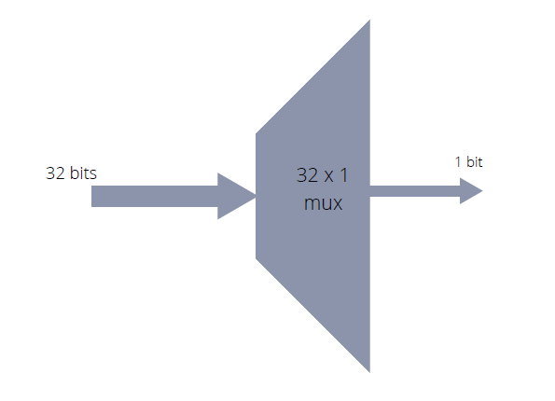
Architecture of the Design
Unit inside Braille to BCD convertor

Slide 4
Flowchart of main.v file
mux2to1.v
bcdx3.v
bcdx2.v
mux4to1.v
bcdx1.v
bcdx0.v
A
mux16to1.v
bcdy3.v
bcdy2.v
mux32to1.v
bcdy1.v
bcdy0.v

Slide 5
Flowchart of main.v file
Start
INPUT A,B,C,D,E,F
A
braille_to_bcd_decoder.v
bcd_to_7_segment_decoder.v
B

Slide 6
Flowchart of main.v file
B
Output for x in 7 segment led
Output for y in another 7 segment led
OUTPUT a,b,c,d,e,f,g
OUTPUT a,b,c,d,e,f,g
Stop

Slide 7
Major Challenges Faced
To convert six variables which form the dots of braille cells i.e. braille code to ASCII values, initially we used K-map and designed it in behavioral form but to change it into structural form, the very first difficulty we face to get the architectural design of our project.
Thereafter, we came up with an idea of using multiplexer to reduce the complexity of our program.
While coding our module, we got different type of errors. One of them is such as “invalid port expression error”.
Initially, we instantiated all the 4 to 1 multiplexers in same module which is not a good practice. So, we change the code in separate modules and created higher order multiplexers to make code much easier to understand than earlier.

Slide 8
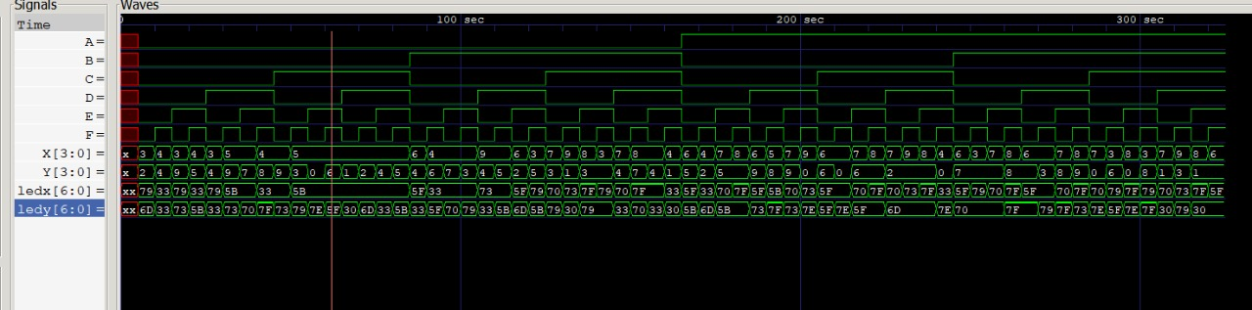
Simulation Results
Inputs and outputs in wave form

Slide 9
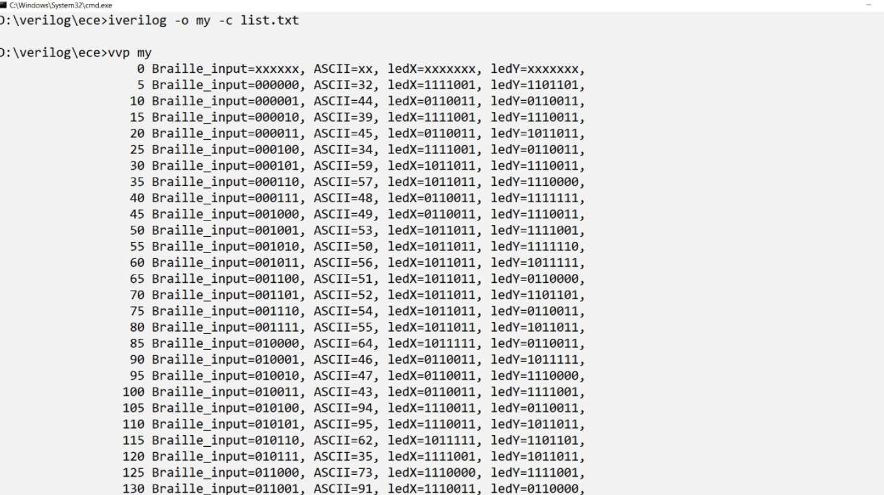
Simulation Results
Braille inputs and outputs on 7 segment displays (in ASCII form)

Slide 10
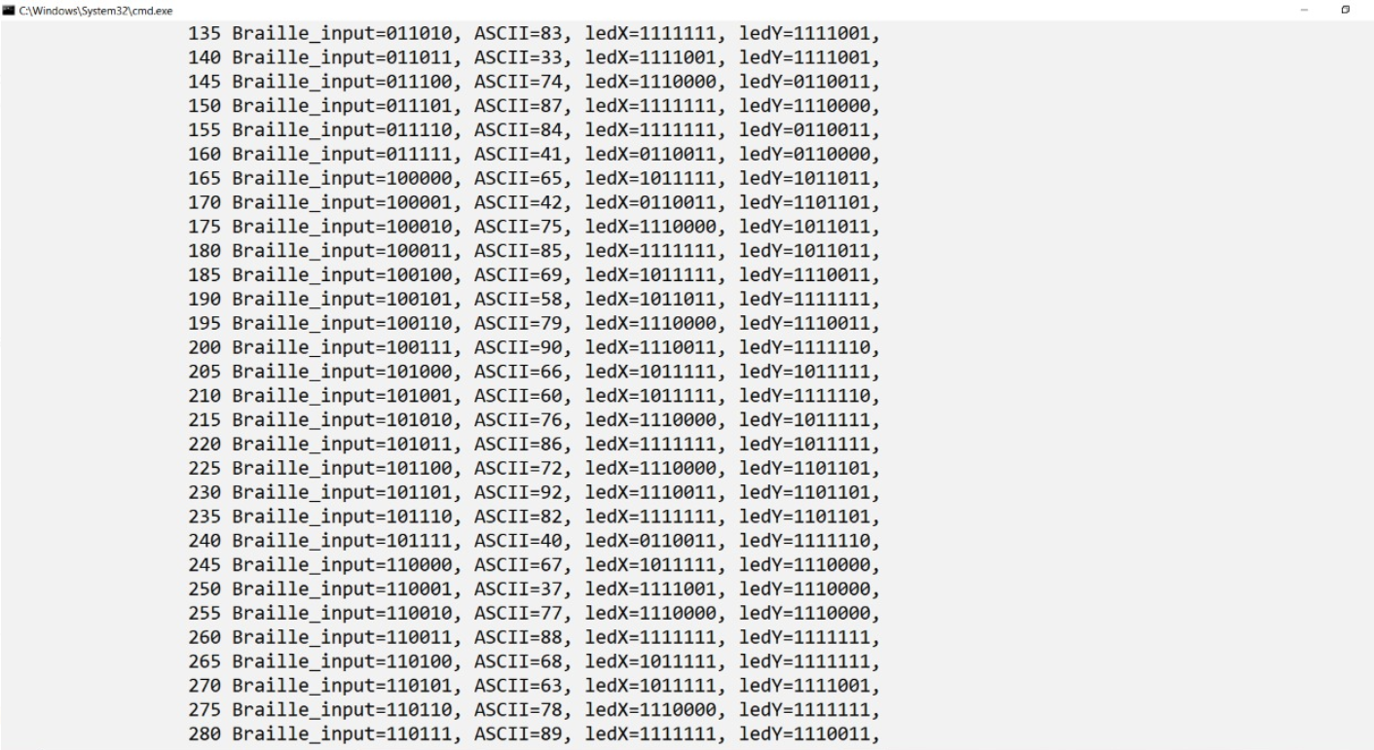
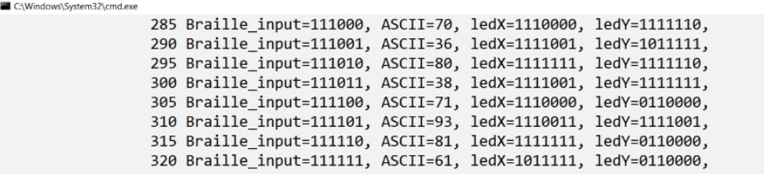
Simulation Results

Slide 11
Summary
Braille translator can potentially be helpful tool for visually impaired people to overcome the challenges faced by them through effective communication.
We have effectively learned the basics of Verilog modeling language by completing this project.
We tried using various procedures and with each successive procedure, we have managed to build up a hierarchy and reduce the complexity of design of our project.
To make this braille translator, we have created Verilog modules as the building block to convert braille notation into ASCII value.

